Slide 1

8th Annual Global Pharmacovigilance Summit
“
September 12, 2024
“
Harnessing Artificial Intelligence for Enhanced Drug Safety

Slide 2
About PVExcel
AI enabled Product Portfolio for bridging gaps in business processes and addressing regulatory challenges
Established in 2019, PVExcel (PV Excellence) is an Artificial Intelligence Consulting Company with expertise in implementation of the Pharmacovigilance and Drug Safety applications and producing AI-powered solutions for superior safety outcomes, regulatory compliance and operational efficiency.
Custom solutions and Services, including Safety System implementations, data migration and integration
PV domain experts, IT consulting leaders with proven industry experience
AI-AUGMENTATION
PROJECT MANAGEMENT
BUSINESS CONFIGURATION & TECHNOLOGY
ASSOCIATED SERVICES
Program Managers with over two decades of experience with leading Pharma companies Pfizer, Merck, Amgen, Otsuka, Novartis, GEHC, Sun Pharma, Bayer, GSK and BMS to name a few
Designing and developing business configuration, Integrating EDC systems with Safety , Implementing E2B R2 and R3 for EMA, China, Korea, FDA, Japan
Designing and developing custom PV solutions and reports
Safety System Upgrade
Testing and Validation services for Safety implementation and integration projects
Validation for AI-based solutions
Data Migration, Reporting, and Safety Signal detection Solutions

Slide 3
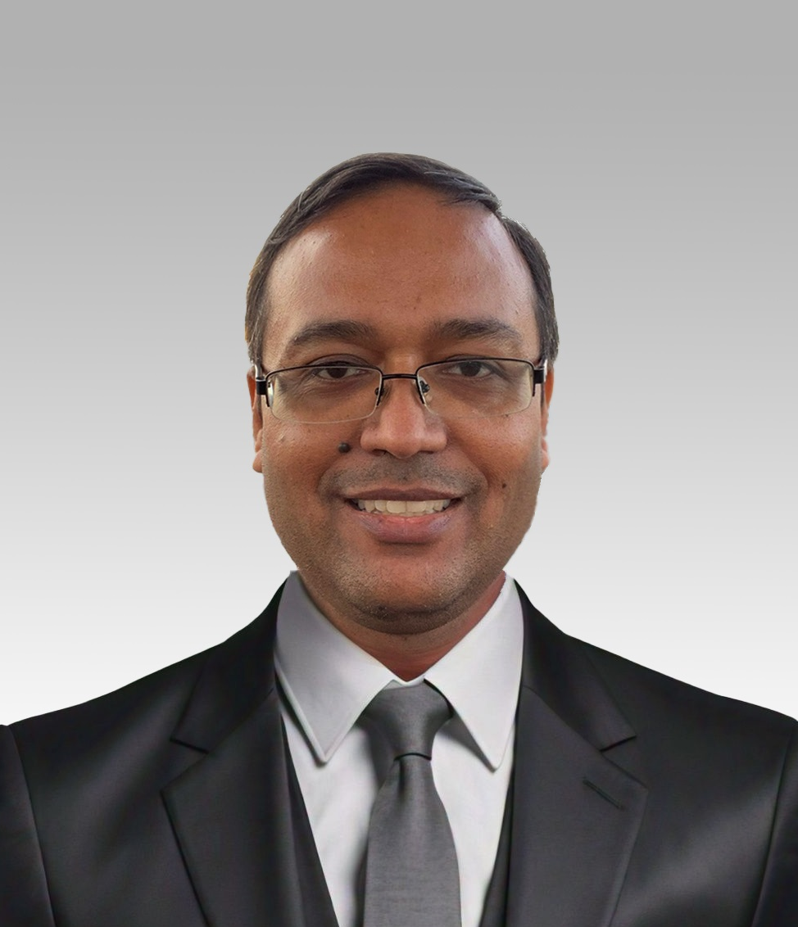
Presenter: Sikandar Kumar – Co-founder & CEO PVExcel
Trusted advisor and subject matter expert in the Pharmaceutical Drug Safety domain.
Over 20 years of experience in Safety solutions consultation, design/development, and implementation with multiple Tier I & II clients.
Provides highly specialized and niche business solutions offerings and delivers business-aligned architectures promoting agility centered on Pharmaceutical's core challenges.
Co-authored and architected Oracle’s Argus Safety and Signaling solutions.
Worked as Director & Safety Solutions Architect at Oracle until 2017 and led various Safety Implementations/Upgrades

Slide 4
The Future Landscape of Drug Safety with AI
Progress Made
Current Landscape
Future with AI
Combining AI & Business Rules
Vision
Extraction of structured information from unstructured data (e.g., Case Narrative).
Automated parsing of source documents.
Language translation capabilities.
Full Automation: Data entry from various sources will be fully automated.
Medical Review Enhancement: AI will suggest Case Causality and other critical items using patient profiles and Patient histories.
Data Entry: Consumes significant time and resources.
Business & Medical Review: Key stages after data entry.
Safety Net: Business rules to safeguards against AI errors, such as hallucinations.
Ensuring Accuracy Guarantees key areas are correctly represented and maintains data integrity
Efficient, Reliable Drug Safety: AI combined with Business Rules will revolutionize safety processes, enhancing efficiency, reducing costs, and improving overall accuracy in drug safety.
AI's Journey in
Drug Safety
Transforming
Drug Safety Process
The Road
Ahead
Role of
Business Rules
Conclusion

Slide 5

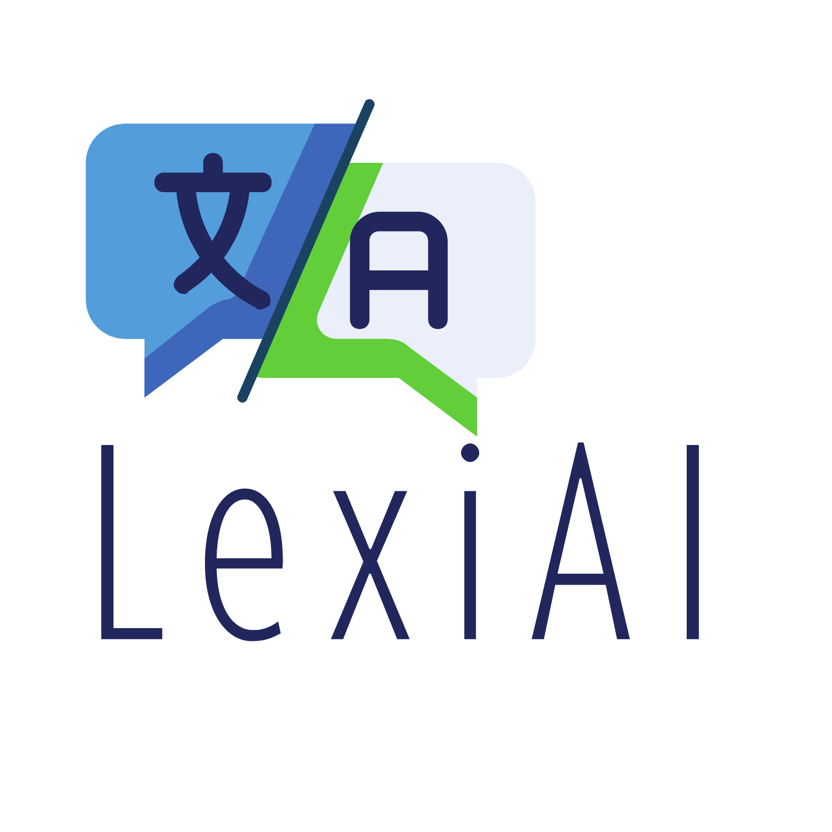
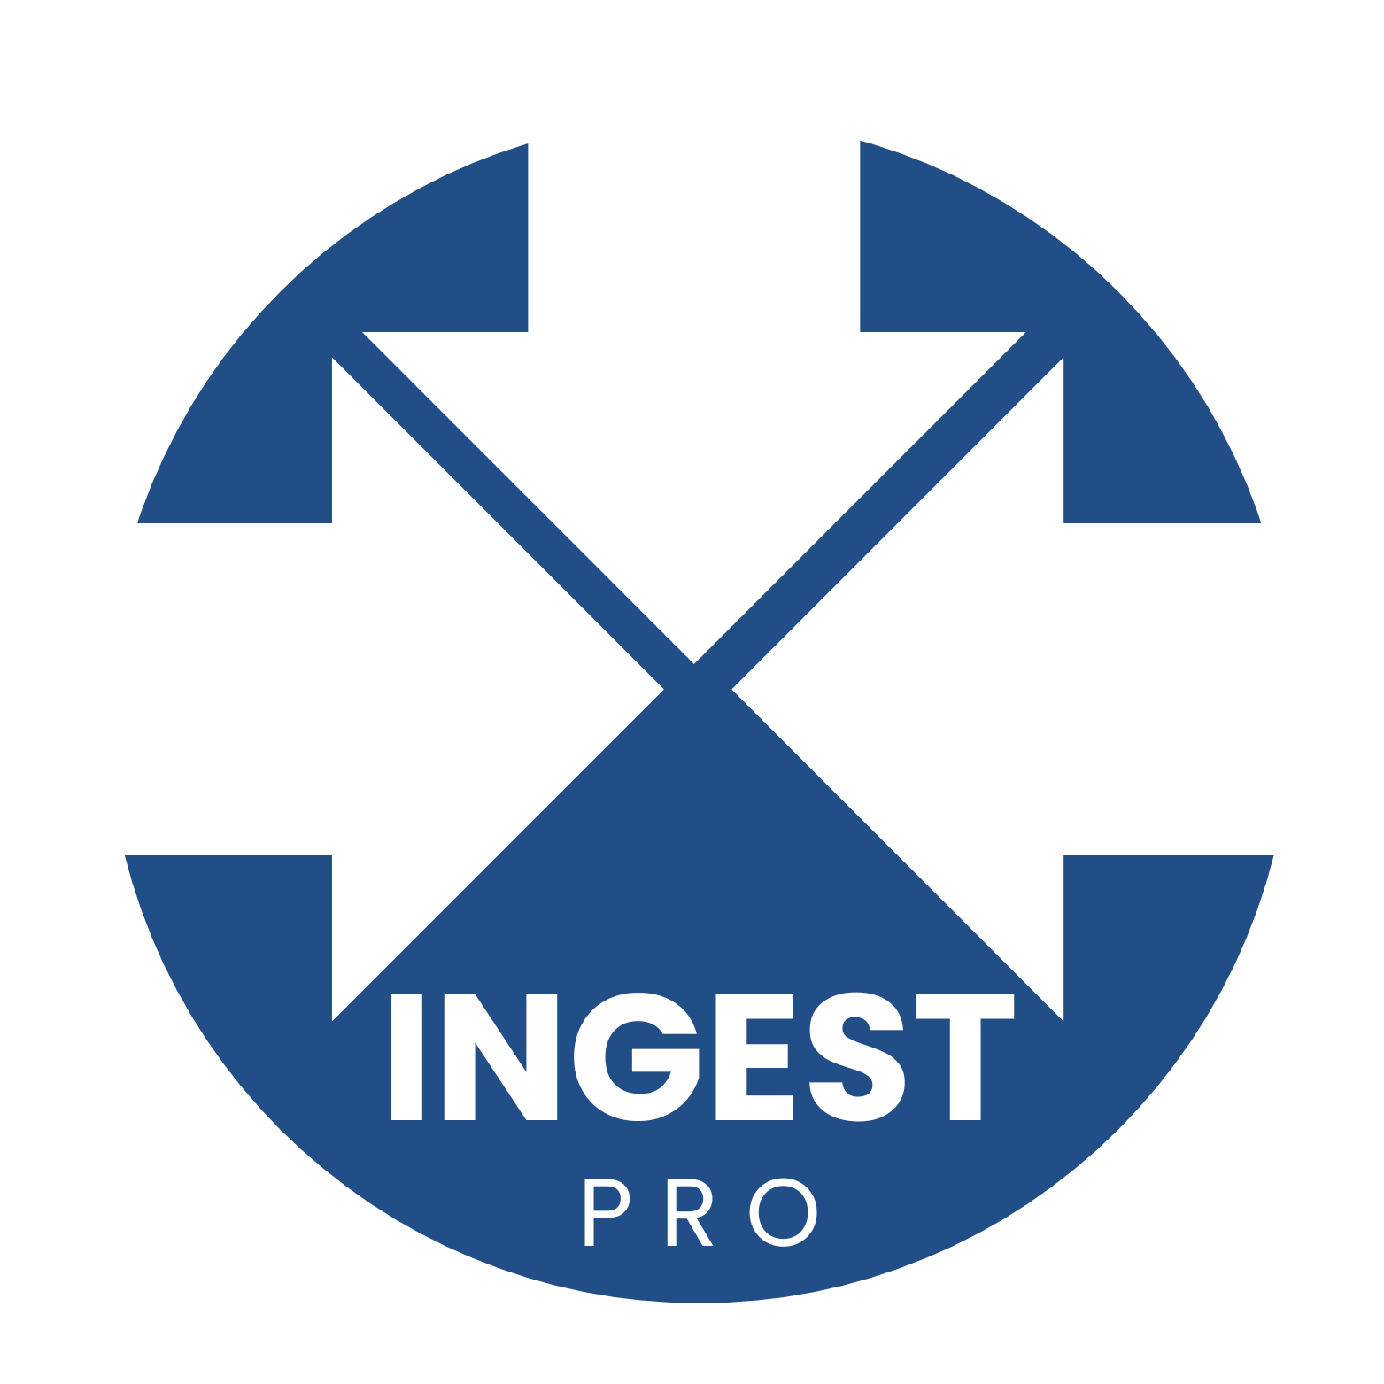

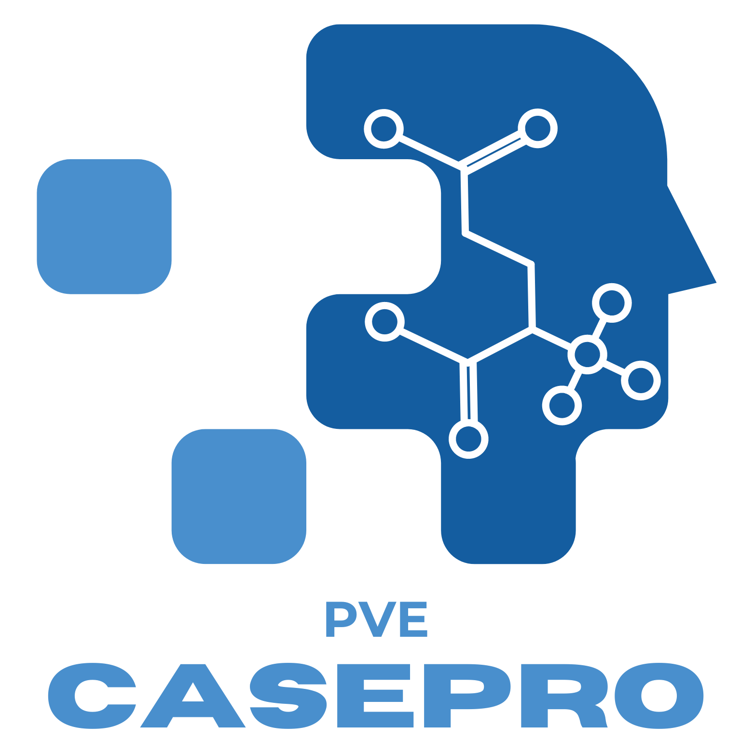
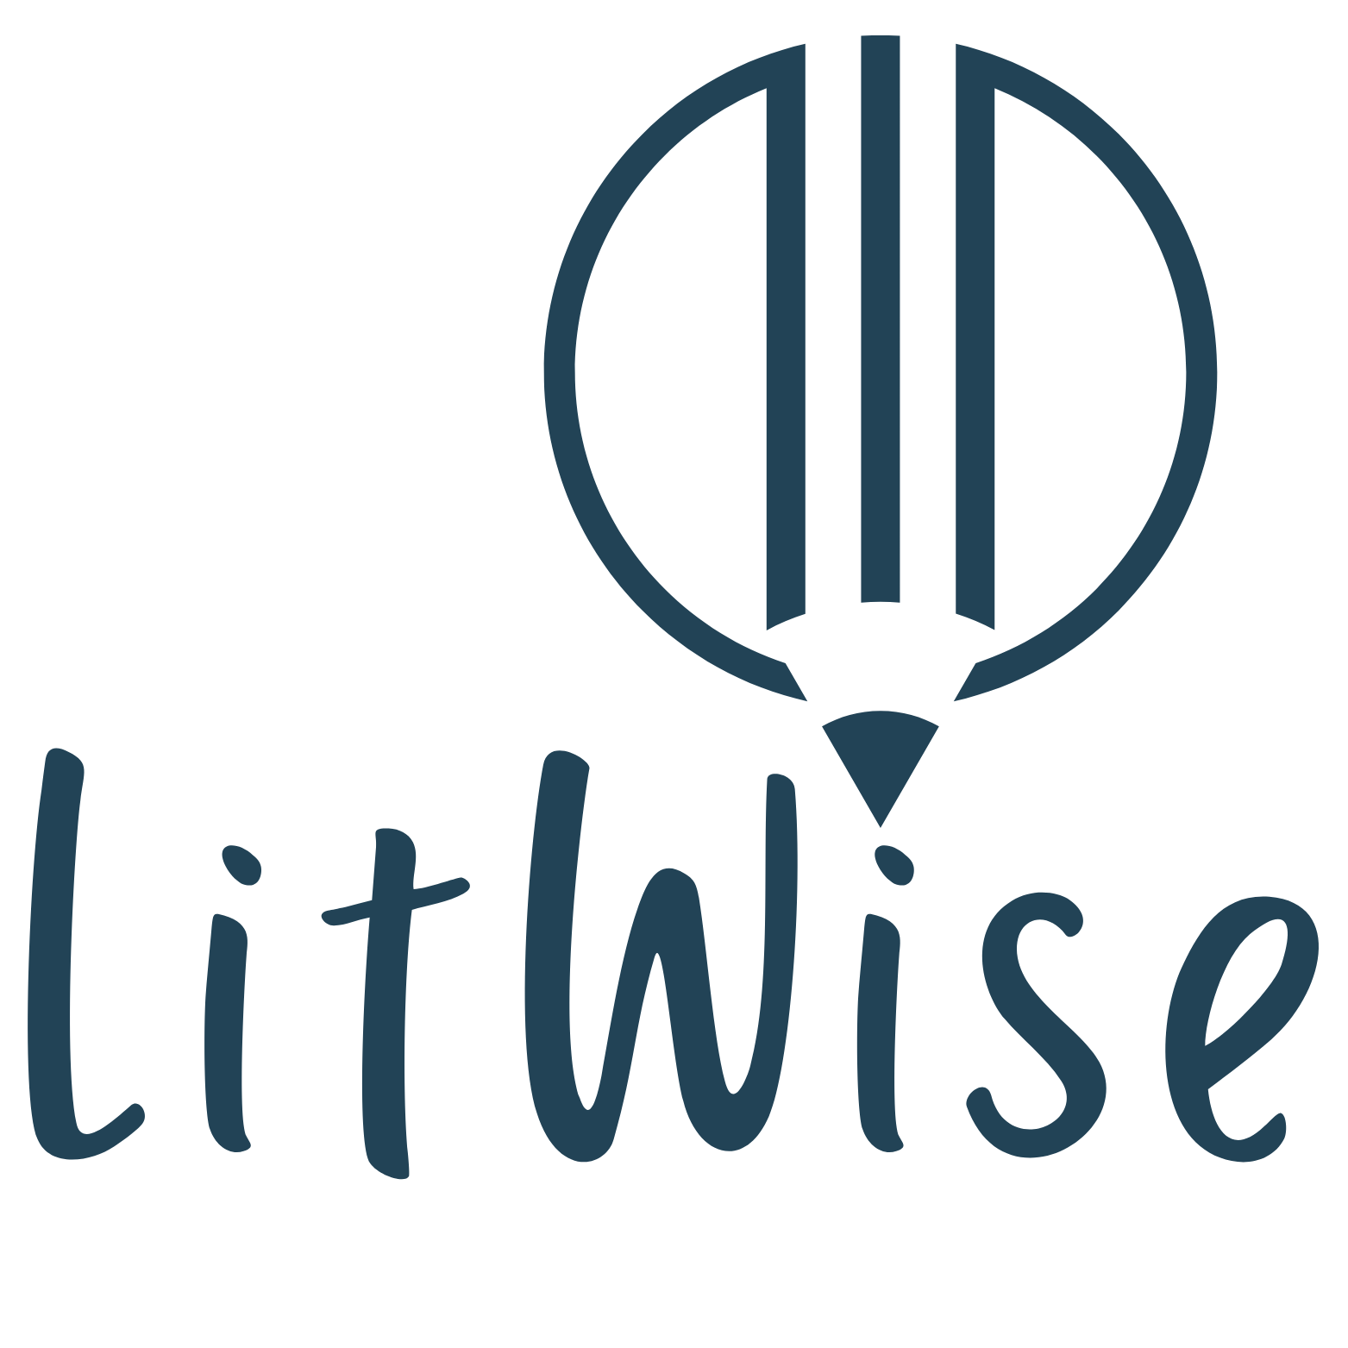
Sustainable Artificial Intelligence
What is Sustainable AI ?
COST TO RE-LEARN & REFINE THE MODEL: The cost to refine can be as high as creating a new model. PV Excel’s dedicated monitoring team ensures that the refinement cost is reduced to a mere 7 - 10 %
FEEDBACK LOOP TO ENSURE CONTINUOUS LEARNING: The solution should be smart enough to learn on a continuous basis to keep it relevant for the business for as long as possible.
CHALLENGES WITH DATA BIAS & HALLUCINATION: Lack of available data for a segment doesn’t obliterate its relevance. AI solutions can tend to either overlook it or try to overcompensate it by creating its own statistics causing it to hallucinate.

Slide 6
Challenges / Opportunity Areas
Similarity Analysis | Severity & Causality | Follow-Up
Summarization | Predictive Analysis | Targeted Search
Unable to match similar characteristics
Can’t auto-assess ‘potential’ causality
Follow-up narratives are added or replaced, not added as delta changes
Manual intervention in creating precise summaries
Little or No support for proactive risk management
Targeted literature searches are cumbersome or limited
Assessment & Narratives
Literature & Duplicate Search
Extraction | Classification | Organization
Challenges in extracting essential data points
Unable to categorize efficiently by type
Requires manual intervention for organizing
Lexical Errors | Support Issues
Inaccurate initial translations
Cost issues
Regulatory compliance for cloud services
Limited on-prem options
Document Parsing & Intake
Translation

Slide 7
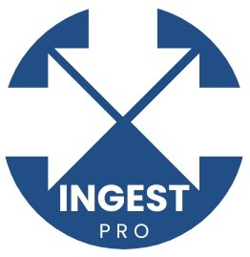
IngestPro: AI for Document Parsing and Case Intake
PV Excel’s IngestPro can parse Structured and Unstructured data for Safety System Ingestion.
It can precisely extract and classify data from multiple sources, including social media, automate case management for quicker processing, and transmit to Safety solutions.
Scalable and configurable, ensures regulatory compliance, and has excellent data protection.
Capabilities
• Natural Language Processing (NLP)
• Automated Data Validation & Entry
• Advanced Case Prioritization
• Real-Time Notifications & Alerts
Key Features
Automated Data Extraction: IngestPro can extract essential data points like patient demographics, drug information, dosages, and adverse events from a variety of document formats. It can extract critical information from structured documents like clinical reports and regulatory filings, as well as unstructured data such as reports from healthcare professionals.
Efficient Document Classification: Documents are automatically categorized by type (e.g., clinical trial report, spontaneous report) to streamline routing and processing.
Data Organization: Extracted data is structured into organized formats, significantly reducing manual data entry and improving data quality.

Slide 8
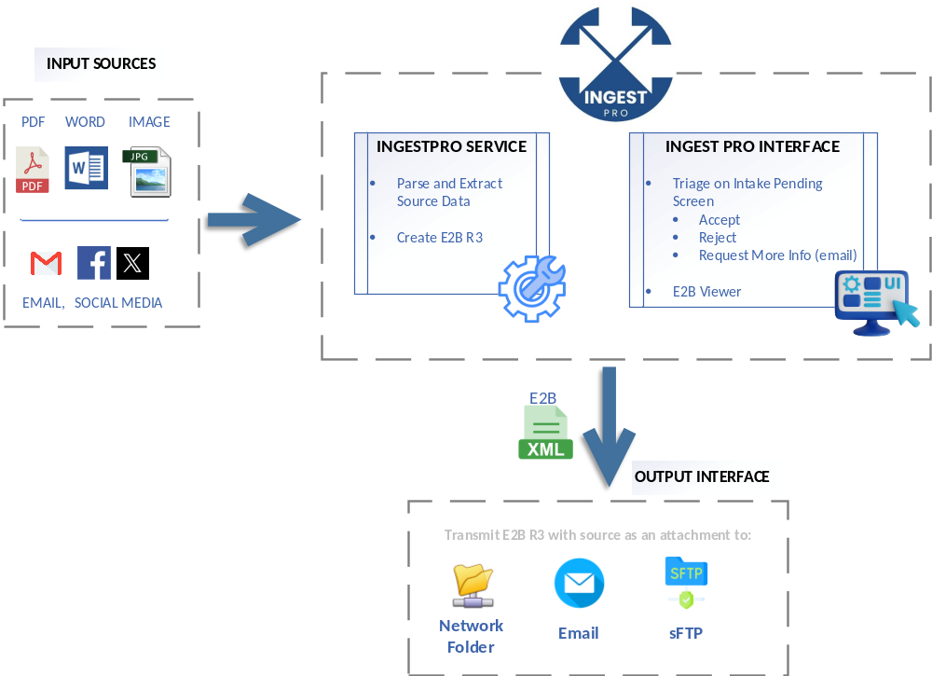
IngestPro: AI for Document Parsing and Case Intake

Slide 9
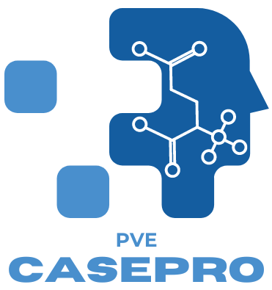
PVE CasePro: AI Enhanced Case Assessment |Automated Narratives
PVE CasePro leverages historical data and advanced algorithms to provide comprehensive and accurate case assessments by processing and comparing similar case assessments done previously.
CasePro uses AI to read through the available fields and narrative text to create a delta follow-up narrative that blends seamlessly with the existing case narrative to produce a delta narrative for follow-up that can be reviewed and accepted with the click of a button.
Key Features
Case Similarity Analysis: PVE CasePro identifies cases with similar characteristics, providing valuable insights and facilitating informed assessments.
Severity Classification and Causality Assessment: It categorizes case severity and assesses potential causality, enhancing the accuracy of risk management strategies.
Continuous Learning and Improvement: PVE CasePro improves with each new case, gaining knowledge over time and leading to more accurate and consistent evaluations.
Delta Narrative Generation: PVE CasePro generates concise narratives highlighting key changes and new information, which are then seamlessly integrated into the existing case narrative.

Slide 10
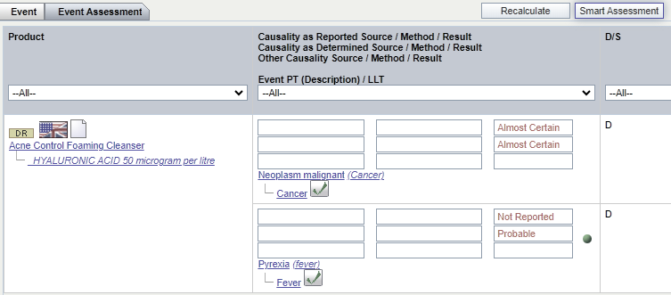
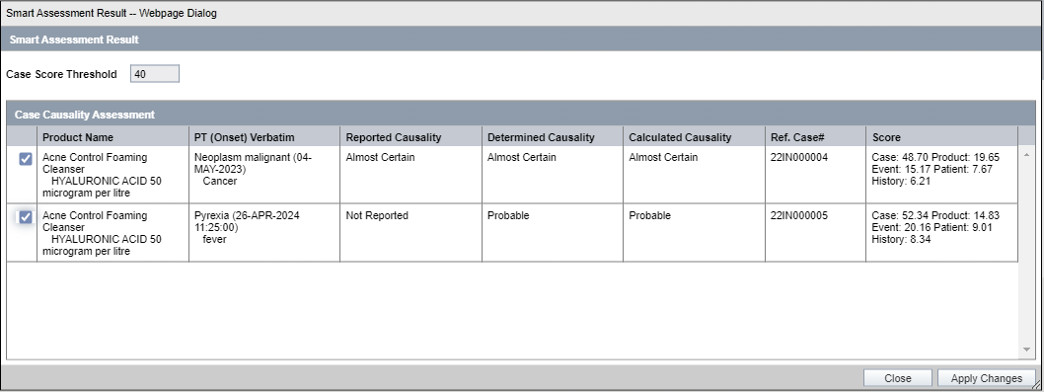
PVE CasePro: AI Enhanced Case Assessment |Automated Narratives

Slide 11

PVE LitWise: Intelligent Literature Search
PVE LitWise is an advanced AI solution that can parse and index literature articles and sources to be utilized for literature search using Natural Language Processing to provide actionable insights.
It is capable of semantically extracting useful information from scientific literature allowing a better and informed understanding of drug’s safety profile to provide knowledge-based results. It allows users to search on structured and unstructured documents and images.
Key Features
Ontology-Enabled Search: PVE LitWise can identify and classify drug names, indications, side effects, and patient demographics, facilitating a more targeted search.
Automated Summarization: LitWise can generate concise summaries of relevant literature, helping researchers quickly grasp key findings and potential safety concerns.
Enhanced Predictive Analysis: It can predict potential adverse events by analyzing vast literature, supporting proactive risk management.

Slide 12
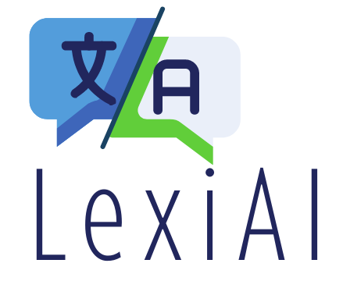
PVE LexiAI: Bridging the Language Gap with AI Powered Translation
PVE LexiAI works as a translation service for seamless and accurate translations harnessing the power of an organization’s translation tools to integrate it across a platform or an application suite.
It combines the AI-powered translation with user-preferred translation services to streamline processing of Adverse Event and Safety data in multiple languages.
Key Features
In-House Translation Service: Cutting-edge AI translation engine enables LexiAI to provide accurate initial translations potentially across any language for which a service is available. Integrates with Clinical, Safety and other PV systems.
  Controlled Access: Sensitive patient and drug safety data remain within the organization, reducing the risk of data breaches.
  Compliant with HIPAA & GDPR: Patient data remains secure within the company network. Request data is not stored or used for future translation requests.
  Seamless Integration: LexiAI allows an organization to scale up its translation capabilities across other PV Systems.
  Comparable to GPT-4o: Ensures efficient updates and reviews by bilingual translators.
  Minimal Review: LexiAI translation outputs require minimal reviews by translators to ensure domain-specific accuracy and relevance.
Cloud-based / Third-Party Translation Service Integration: PV Excel supports integrating Safety and clinical systems with industry-leading translation services.

Slide 13
PVE LexiAI: Bridging the Language Gap with AI Powered Translation
Source Documents
Translating Source Documents on the fly
Electronic Data Source
Configurable DTD elements from E2B XMLs
Case Data Translation
Pre-configured workflow and applicable fields for translation
Auto translation for applicable fields
Auto-routing after successful translation
Zonal translation of source document
Replace / Create a New Translation Node (Refer screens)
IMPLEMENTATION MODES
External cloud-based service | In-house Translation service
Reduces Turnaround Time | Trained AI Model and Tested for key languages
Option to manually override and confirm/accept translation
Implemented for a Tier-1 Pharmaceutical

Slide 14
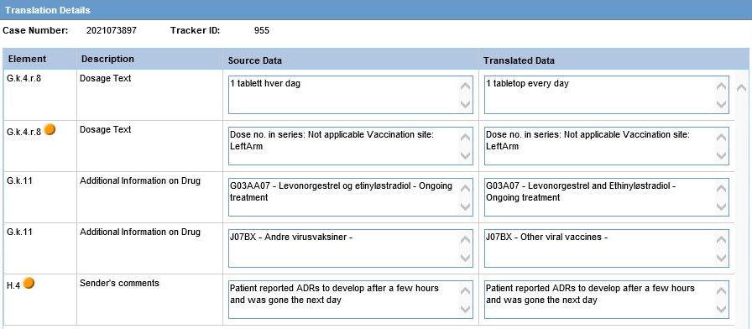
PVE LexiAI: Bridging the Language Gap with AI Powered Translation

Slide 15
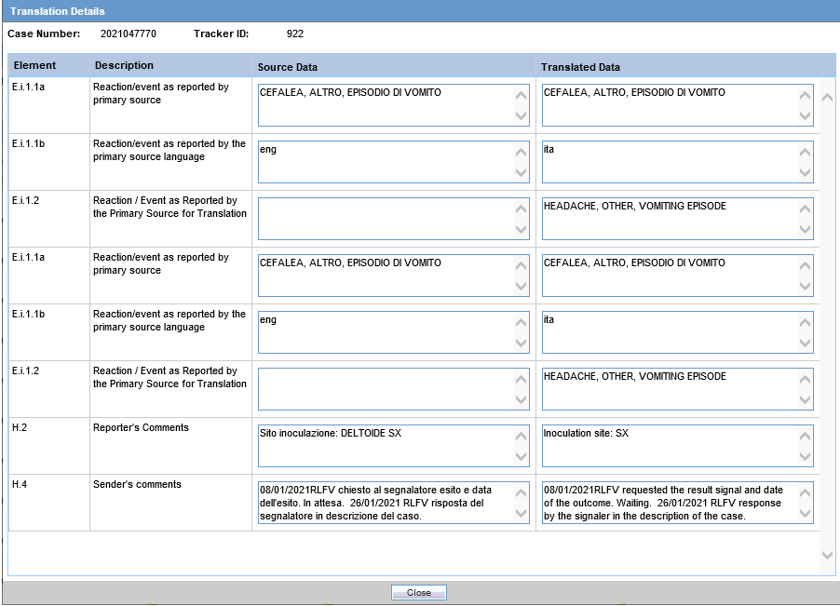
PVE LexiAI: Bridging the Language Gap with AI Powered Translation
Users can review, modify, and confirm the translation.

Slide 16
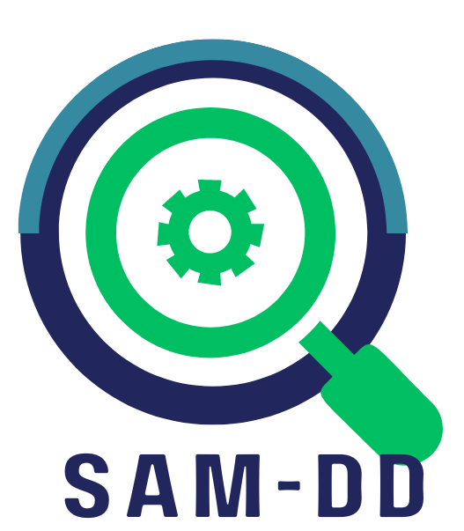
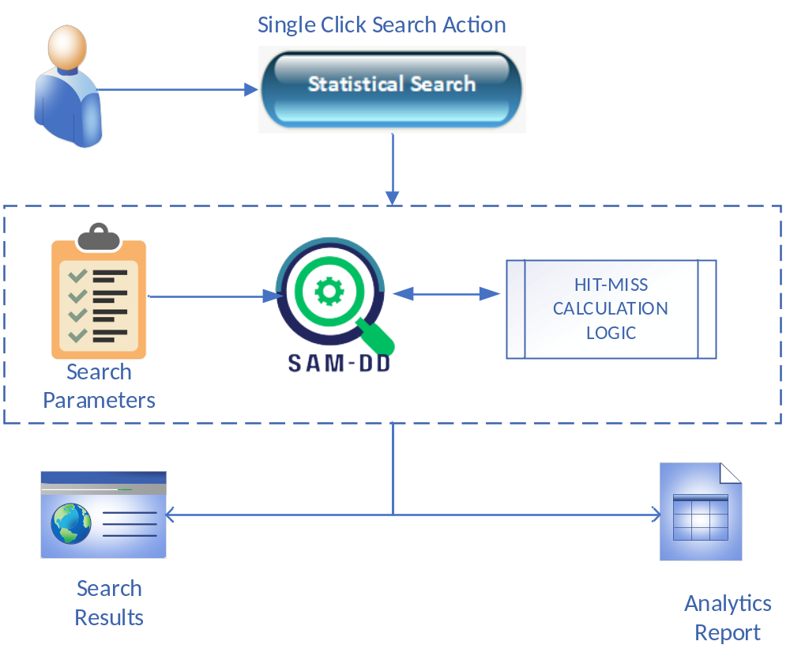
SAM-DD: Statistical Adaptive Model for Duplicate Detection
SAM-DD uses an adaptive statistical model using a Hit-Miss algorithm that takes correlated records into consideration for arriving at a score-based system to identify potential duplicates for an intake record.
Prepares Data:
Calculates Field Level Score:
Calculates Case Level Score:
Filter Result:
Display Result:
Pre-calculate statistical parameters weekly
Using statistical pre-calculated parameters and Case/Intake data
Aggregation of Field Level Score
Identifies result-set meeting a minimum Case Score threshold
Shows filtered result in the descending order of case level score

Slide 17
SAM-DD: Statistical Adaptive Model for Duplicate Detection
Statistical method to finding potential Duplicates
  Allows for a single click search action where a user can simply click the ‘Statistical Search’ button
  System compares “current intake data with all other cases” using pre-configured search parameters (~15-25)
  Each comparison field gets a score within the case pair
  System calculates each field score by using the Statistical “Hit-Miss” algorithm
    A Hit on a rare field value gets a higher score than a more frequent field value
    A Miss on a field gets a negative score
    A Non-Compare (at least one field is empty) is scored as zero
    Weight tables are pre-calculated for each field by counting the individual values and by applying “learning” parameters
    For Text data elements, exact match is considered as match
    For Date or Number data elements, difference is also considered while giving score
Includes an analytics report that can be used to decipher trends in duplicate data, vis-à-vis number of searches resulting in duplicates, source of duplicates, etc.
Integration of SAM-DD with any Intake or Safety Solution

Slide 18
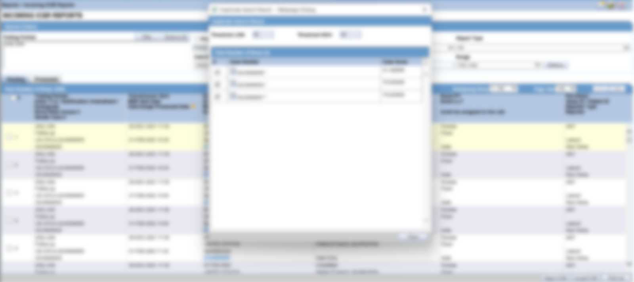
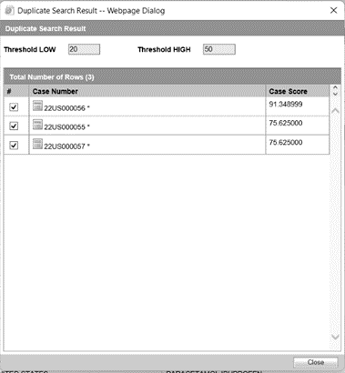
SAM-DD: Statistical Adaptive Model for Duplicate Detection

Slide 19
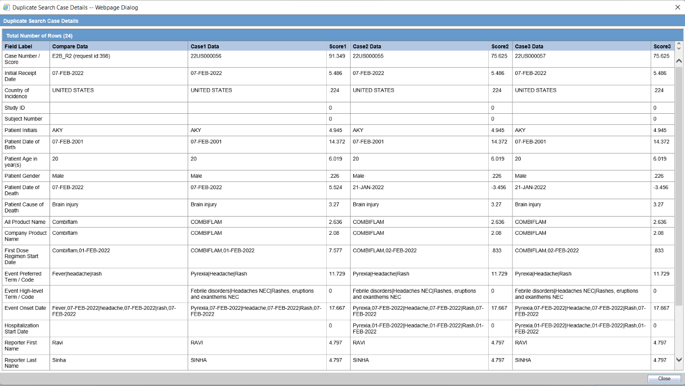
SAM-DD: Statistical Adaptive Model for Duplicate Detection

Slide 20
PVE Data Migration Services
PV Excel offers seamless and precise data migration services tailored to the volume of data, the type of systems involved, and specific business requirements to facilitate efficient system transitions.
USE CASES
MAH Transfers: Changing the Market Authorization Holder requires the transfer of critical safety data to the new holder’s PV system.
System Upgrades: Major upgrades necessitate the migration of data to ensure compatibility with the new system.
System Consolidation: Integrating PV systems from various geographical locations or merging multiple safety systems into a single platform requires robust data migration strategies.
PV Excel Accelerators
E2B Analyzer for identifying any error and data profiling
Rule based E2B Updater
Audit Log and Source Document Loader
Proven Migration Code (DB->DB as well as E2B->DB) used for 50+ migrations
Experience
ArisG →Argus
ArisG →LSMV
Clintrace → Argus
CW5 → Argus
Perceive → Argus
MAH transfers
Global and Japan Integrations
Case Data Merge
Duplicate Detection using SAM-DD

Slide 21

Integration Approach for Product Portfolio
Discovery
Proof of Concept
Implementation
Deployment
Review of the application board
Finalize the scope of work (integration and configuration parameters, customization)
Identify risks
Update project schedule and milestone plan
Obtain access and approvals for application integration
Execute a PoC to identify and fix any issues and revise estimates
Finalize interface requirements
Finalize configuration parameters (profile details etc.)
Develop
Verify
Create and execute Installation scripts for Deployments
Acceptance Statement
Other closure activities as applicable
Develop integration code and any custom interfaces
Configure as per final implementation requirements
Perform Unit Testing and hand over the batches to System test team for verification tasks
Fix defects and finalize deliverables
1 Week
2 Weeks
3 Weeks
1 Week
Go-Ahead

Slide 22
Collaboration
PVExcel
Partner
PV CONSULTING & Solutioning VENDOR
PROJECT OWNER | CLIENT | PROMOTER
CONSULTING SUPPORT & PROJECTS
VALIDATION AND TRAINING SERVICES
PVExcel can support on various Safety consulting projects and specialized assignments to augment or oversee existing project teams or pick up independent pieces
PVExcel can supplement and provide for validation and training services for drug safety implementations & projects.
PRODUCT PORTFOLIO AND CUSTOM SOLUTIONS
PROJECT OVERSIGHT & MANAGEMENT SUPPORT
PVExcel can architect and provide for custom solutions and tools on existing or upcoming opportunities. Existing product portfolio can be presented for utilization on prior agreed terms.
PVExcel can offer project oversight and management support and help organize and setup practices or verticals as needed.

Slide 23





Contact Us
WEB
www.pvexcel.com
EMAIL
contactus@pvexcel.com
PHONE
Planned
+1 949 231 0715
+1 949 310 2336

